Slide 1
The PIC microcontroller
PIC18F4520: Configuration Bits

Slide 2
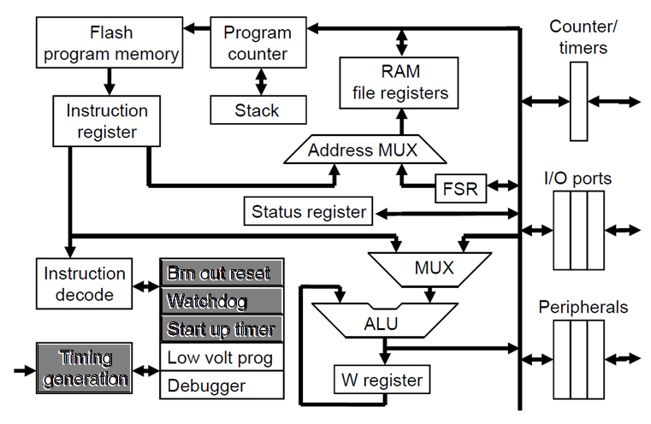
PIC18F: Controller Architecture

Slide 3
PIC18F: Notational convention
WREG
W Register
FREG
File Register (any register location from GPR Bank 0 / SFR)
[X]
Contents of register X
[WREG] = 0x02 ↔ WREG’s contents become 0x02
[0x20] = 0x34 ↔ RAM File Register 0x20 content becomes 0x34
[X] = [Y] ↔ Contents of Y are copied into X
Number systems
Decimal | d’10’
Hexadecimal | h’4A’ or 0x4A
Binary | b’1000 0010’

Slide 4
pic18F Config bits

Slide 5
PIC18F: Configuration Bits
Configuration Bits
Control the PIC’s behavior
Enable / Disable various hardware features of the PIC
Available through Config Registers
Addresses 0x300001 through 0x30000D
Significant ones:
CONFIG1H (0x300001): Frequency / Oscillator Selection
CONFIG2L (0x300002): PWRT and BOR Control
CONFIG2H (0x300003): WDT Control

Slide 6
PIC18F4520: CONFIG1H
IESO: Internal/external oscillator switchover bit
FCMEN: Failsafe clock monitor enable bit
FOSC3:0 <4 bits>
0000: LP
0001: XT
0010: HS
0011: External RC, CLK0 on RA6
0100: External clock, CLK0 on RA6
0101: External clock, RA6 as port pin
0110: HS, PLL enabled
0111: External RC, RA6 as port pin
1000: Internal oscillator block, RA6, RA7 as port pins
1001: Internal oscillator block, CLK0 on RA6, RA7 as port pin
101x, 11xx: External RC, CLK0 on RA6
IESO
FCMEN
-
-
FOSC3
FOSC2
FOSC1
FOSC0
f_{OSC}
PIC18F4520
RA7
f_{OSC}/4
RA6

Slide 7
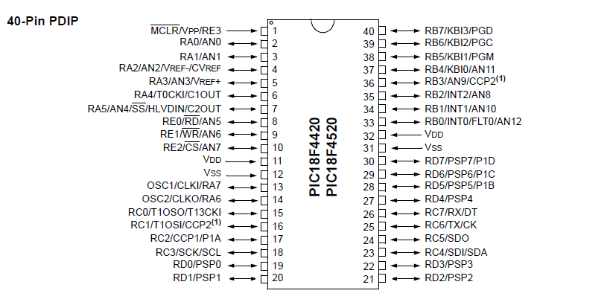
PIC18F4520: OSC1/CLKI/RA7, OSC2/CLKO/RA6

Slide 8
Clock config and system design

Slide 9
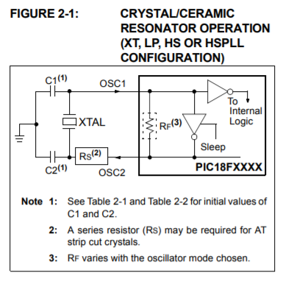
PIC18F4520: Clock circuits (LP, XT, HS)
Circuit schematic(s)
Clock modes
FOSC<3:0>
0000: LP
Low-power crystal
0001: XT
Crystal / resonator
0010: HS
High-speed crystal

Slide 10
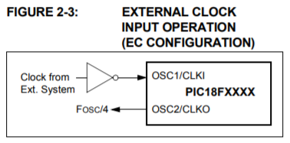
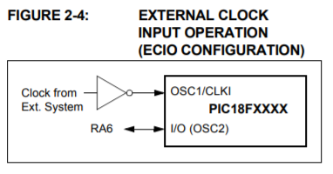
PIC18F4520: Clock circuits (EC, ECIO)
Circuit schematic(s)
Clock modes
FOSC<3:0>
0100: EC
(external clock, CLK0 on RA6)
0101: ECIO
(external clock, IO on RA6)

Slide 11
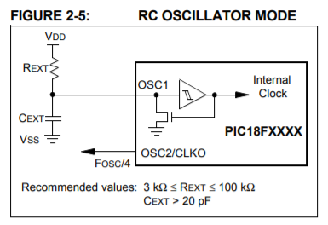
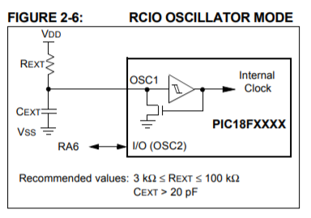
PIC18F4520: Clock circuits (RC, RCIO)
Circuit schematic(s)
Clock modes
FOSC<3:0>
0011, 101x, 11xx: RC
(external RC, CLK0 on RA6)
0111: RCIO
(external RC, IO on RA6)

Slide 12
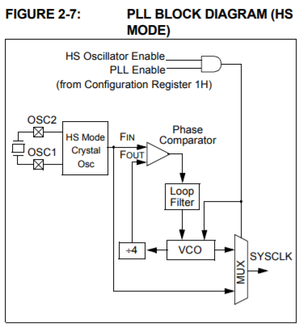
PIC18F4520: Clock circuits (HS-PLL)
Circuit schematic
Clock mode
FOSC<3:0>
0110: HS-PLL
(High-speed crystal, PLL enabled)

Slide 13
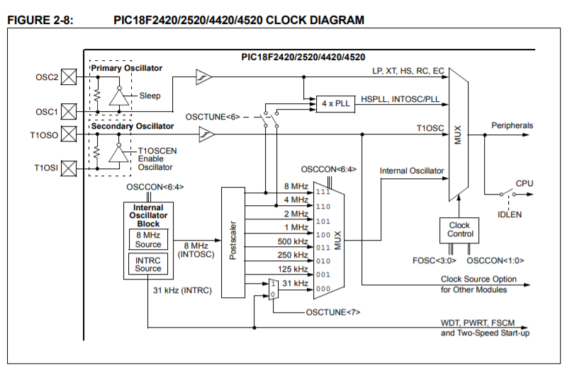
PIC18F4520: Internal Clock Block
FOSC<3:0>: 1000, 1001: Internal Clock

Slide 14
PIC18F4520: CONFIG2L
BORV<1:0>: Brown-out reset voltage bits
11: Minimum setting (2.00V min)
10: 2.65V min
01: 4.11V min
00: Maximum setting (4.36V min)
BOREN<1:0>: Brown-out reset enable bits
00: BOR disabled in hardware as well as software
01: BOR enabled, controlled in software (runtime enable/disable)
10: BOR enabled in hardware, disabled in sleep mode
11: BOR enabled in hardware only
PWRTEN: Power-up timer enable bit
1: PWRT enabled, 0: disabled
-
-
-
BORV1
BORV0
BOREN1
BOREN0
PWRTEN
LP (low power)

Slide 15
PIC18F4520: CONFIG2H
WDTPS<3:0>: Watchdog timer post-scale select bits
0000 → 1:1
0001 → 1:2
0010 → 1:4
…
1110 → 1:16384
1111 → 1:32768
WDTEN: Watchdog timer enable bit
1: WDT enabled, 0: WDT disabled
-
-
-
WDTPS3
WDTPS2
WDTPS1
WDTPS0
WDTEN
Watchdog Timer info:
Driven by internal oscillator
Nominal ~4msecs, can be post-scaled to ~131secs

Slide 16
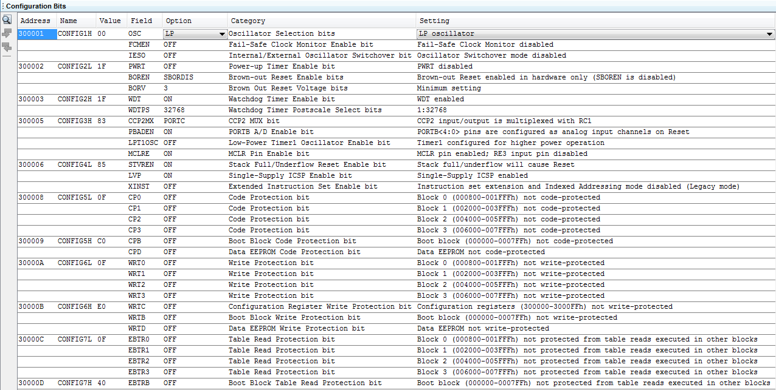
PIC18F4520: Config Bits control in IDE
Configuration Bits window in MPLABX IDE

Slide 17
PIC18F4520: Config bits summary
Configuration Bits
Control the behavior of the PIC
Enable / disable various hardware features
Available as a user-friendly, editable table in MPLABX IDE
Automatic code generation (for inserting into project)
For more details, link to the Controller Datasheet
http://ww1.microchip.com/downloads/en/DeviceDoc/39631E.pdf

Slide 18
Thank you!

